Slide 1

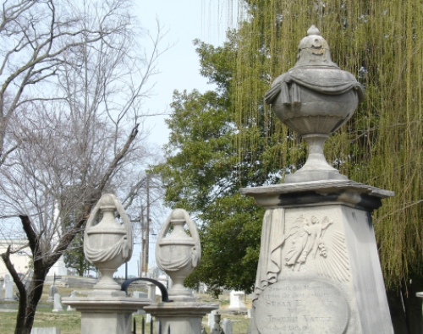
DDA10 Nashville City Cemetery Patrick Johnston

Slide 2





I hate cemeteries.
Therefore, I decided to take a different route.

Slide 3
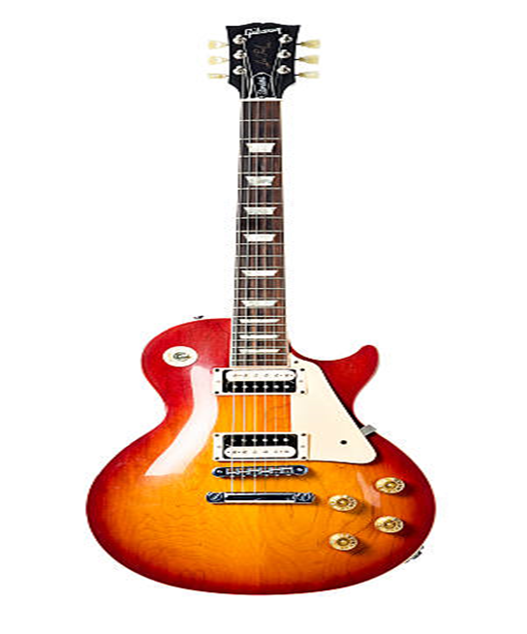
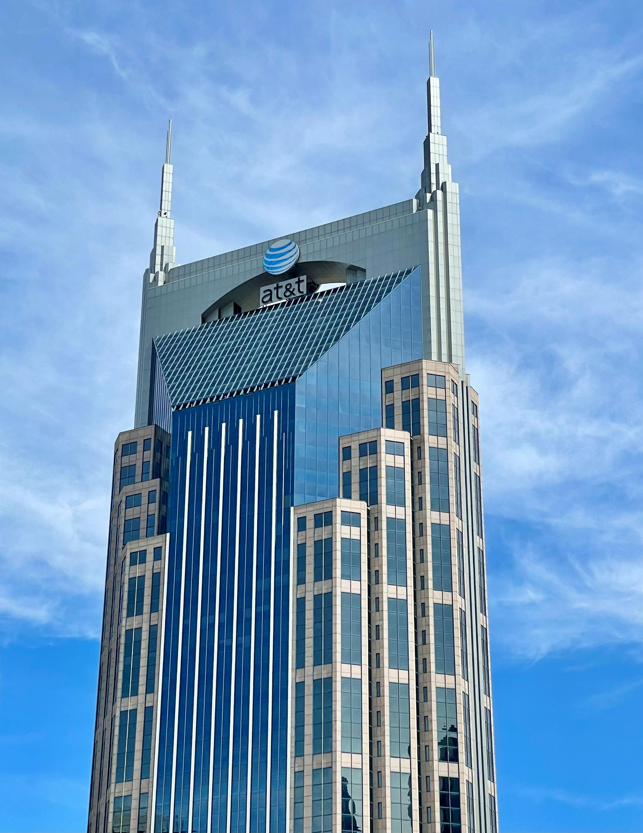

The Subjects:
Iconic Batman building
Standard Gibson Guitar
And of course, Nashville City Cemetery!

Slide 4
Interesting statistical tidbits.
Gibson Guitars | Nashville City Cemetery | Batman Building
38 inch length | 28 acres | 617 feet in height
13 inch width | 1,219,680 square feet | Iconic Nashville building
109,552 guitars for coverage | 54,014,080 square inches | Surrounded by “woo-girls” on their bachelorette parties.

Slide 5


Example of said woo-girls and a typical reaction of locals:

Slide 6
Nashville City Cemetery Acreage Totals
Acreage | Square Feet | Square Inches
28 | 43,560 | 54,014,080

Slide 7
Original Height Comparison

Slide 8
Adjusted values

Slide 9
Conclusion
If we were to stack up the total amount of Gibson guitars required to cover the acreage of NCC vertically, it was measure up to 4,162,976 inches ---- or 65.7 miles!
We could fit just a little bit over 562 batman buildings in that span of distance!

Slide 10
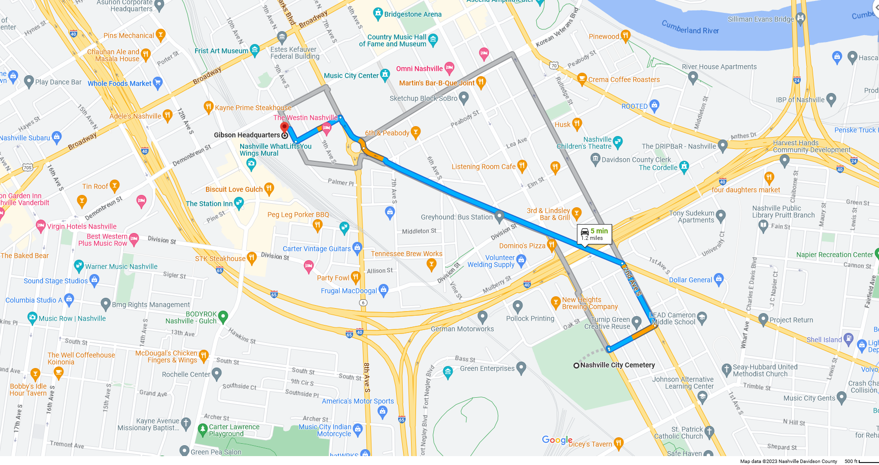
NCC to Gibson Headquarters

